Slide 1





Buy Now Pay Later
Provide a flexible payment option that can increase purchases.

Slide 2

Hello!
I am Radoslav Sheytanov-Ruxton
“Product Manager” (sort of) of BNPL at Global Payments

Slide 3
Buy Now Pay Later (BNPL) …
…allows customers to buy products now and pay over time, making it easier for them to make purchases they might otherwise postpone.
…drives higher sales and customer satisfaction, which in turn leads to business growth for merchants.

Slide 4
Stakeholders and Communication
Internal Stakeholders
External Stakeholders
Communication Plan

Slide 5









Product Delivery Approach
Agile Methodology:
Sprint Planning
Development Phases
Feedback Loop

Slide 6
BNPL Roadmap
Initial Development Phase (Month 1-3)
Beta Launch and User Feedback (Month 7-9)
Commercial Launch and Marketing Campaign (Month 13-15)
1
3
5
2
4
6
MVP Development and Testing (Month 4-6)
Full Product Development and Optimization (Month 10-12)
Post-Launch Support and Continuous Improvement (Month 16+)

Slide 7
External Product Delivery
Customer Engagement
Feedback Mechanisms - CRMs, Support channels
Support and Training - Organising training sessions both internally and externally

Slide 8
BNPL Product Features
Flexible Payment Options: Catering different customer needs
Love for Developers: Seamless integration experience
Enhanced Security: Our BNPL providers always follow robust security practices to protect customers’ data

Slide 9

How would you measure success?
KPIs
Customer Feedback
Business Impact

Slide 10
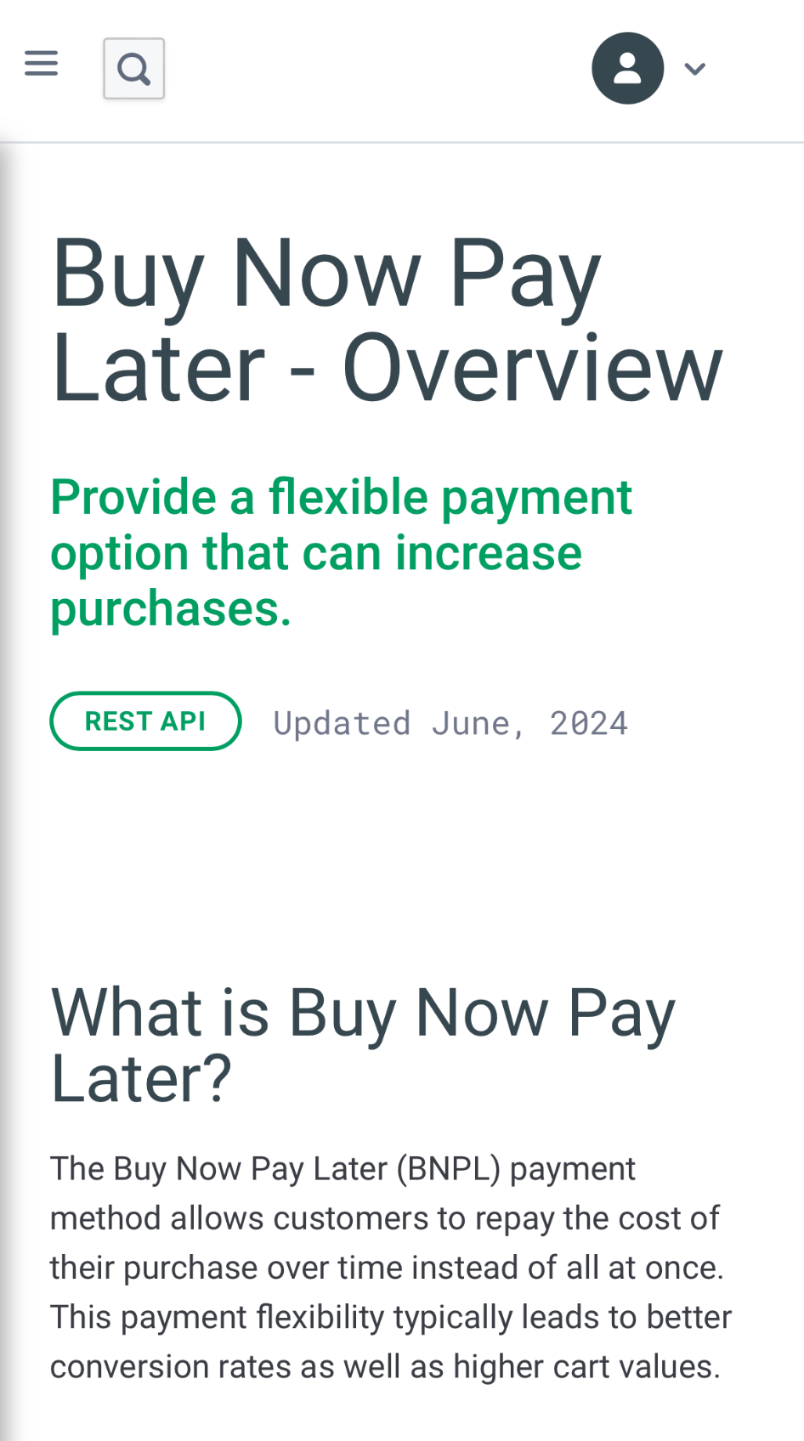
Constant Feedback Iteration!
Constant Product Improvement!

Slide 11
Simplicity is Key!
One Integration - Multiple BNPL Providers
1
Exposure to variety of Global Markets
2
Consolidated reporting via our API and Merchant Portal
3

Slide 12
SWOT Analysis of BNPL
STRENGTHS
Flexible Payment Options
Enriched Customer Experience
Market Reach
WEAKNESSES
- Implementation Complexity
- Consumer Risk
- Merchant Costs
S
W
- Market Growth
- Partnerships
- Technological Advancements
OPPORTUNITIES
- Regulatory Changes
- Competition
- Economic Downturns
THREATS
O
T

Slide 13

Thanks!
Any questions?
You can find me at:
radoslav.sheytanov@globalpay.com

